Slide 1
Android Application – Requirement Tracker
CS673 Group 3:
Iteration 2
4/27/2016
Danny Chiu Brian Kabuye Ayodele Awoleye ChihYung Wu
Josh Wildey

Slide 2
Team Members
Danny Chiu
Team Leader|Requirement Leader|QA Leader
Brian Kabuye
Implementation Leader|App Developer
ChihYung Wu
Design Leader|App Developer
Ayodele Awoleye
Configuration Leader|Server Developer
Josh Wildey
Environment & Integration Leader|Server Developer

Slide 3
Main Objective
We want to create a functional Android application of the Requirement Tracker tool that adds an additional interface to the 3Blueprints website.

Slide 4
Project Tools
Primary communication: Slack
Documentation: Google Drive
Status Tracking: Pivotal Tracker
Programming Software: Android Studio/Eclipse
Version Control: GitHub
Backend/Database: Django database

Slide 5
Iteration 1 Summary
Added RESTful authentication framework using JWT (JSON web token)
Created login screen and sign up screen (GUI).
Added SSL layer to existing Django server.

Slide 6
Iteration 2 Summary
Users are able to sign in and be properly authenticated.
Project list screen (GUI)
Users can view all projects but doesn’t have filtering capabilities yet.

Slide 7
Iteration 3 Summary
Projects are now tied to users, only users assigned to that project can view the project/user stories.
Icebox screen and iteration screen (GUI)
Sign-up screen is now functional.

Slide 8
Requirement Analysis
Functional requirements
Users can use application to view and track projects and user stories.
Non-functional requirements
Portability: Application is readily available through installation of APK files.

Slide 9
Essential Features
User Login Screen
Able to login by using correct credentials.
User Signup Screen
Able to create a new account.
View list of different projects for each account
Selecting each project will display a project information screen.

Slide 10
Essential Features - part 2
View list of user stories associated with project.
Iteration screen will list all user stories associated with current iteration.
Icebox screen will list all user stories that are not on the iteration screen.

Slide 11
User Story Example
Title: Login Authentication
Description:
As a developer, I want to authenticate an existing user by making a HTTP POST request to the server API.
Tasks:
Verify that the Username and Password are actual strings
Develop class to handle API communication
Add functionality to post username and password to the server API
Add functionality to generate a web token on the web server if a user is successfully verified.

Slide 12
User Story Example - part 2
Acceptance Tests:
Given a username and password, an authentication request should be sent to the server API, then the API should process the request and verify the user.
Given a username and password, I want to verify that they are not empty strings, so that the application does not try to authenticate null values.
Given a successful POST request to the server API with correct credentials, a JSON Web Token should be return by the server so the user can access information stored by the server.

Slide 13
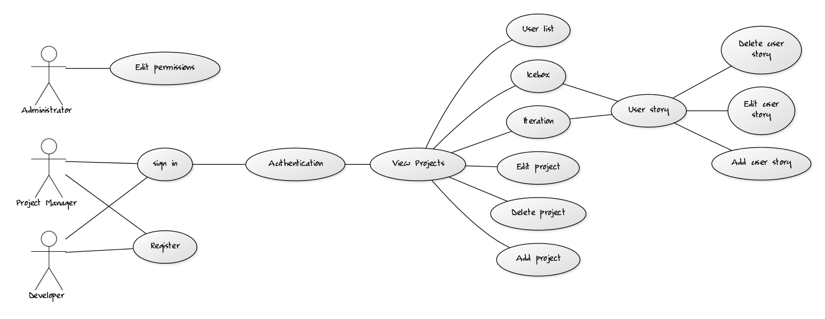
Use Case Diagram

Slide 14
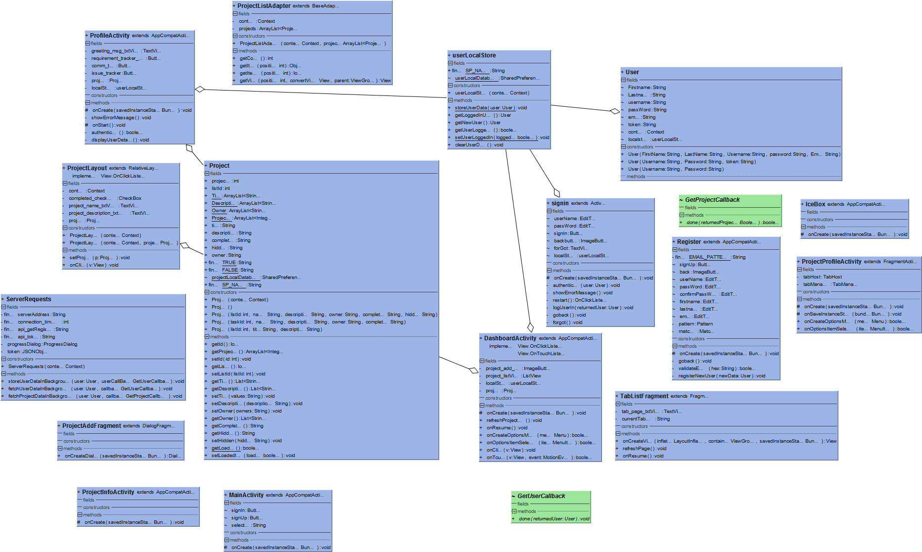
Android Class Diagram

Slide 15
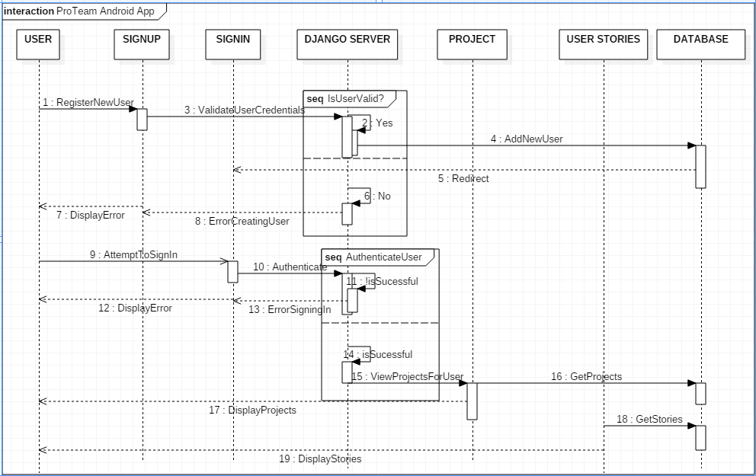
Sequence Diagram

Slide 16
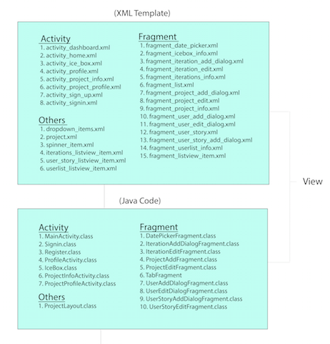
Client Architecture Diagram
(View)

Slide 17
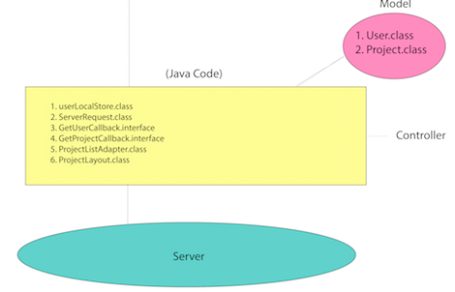
Client Architecture Diagram
(Controller & Model)

Slide 18
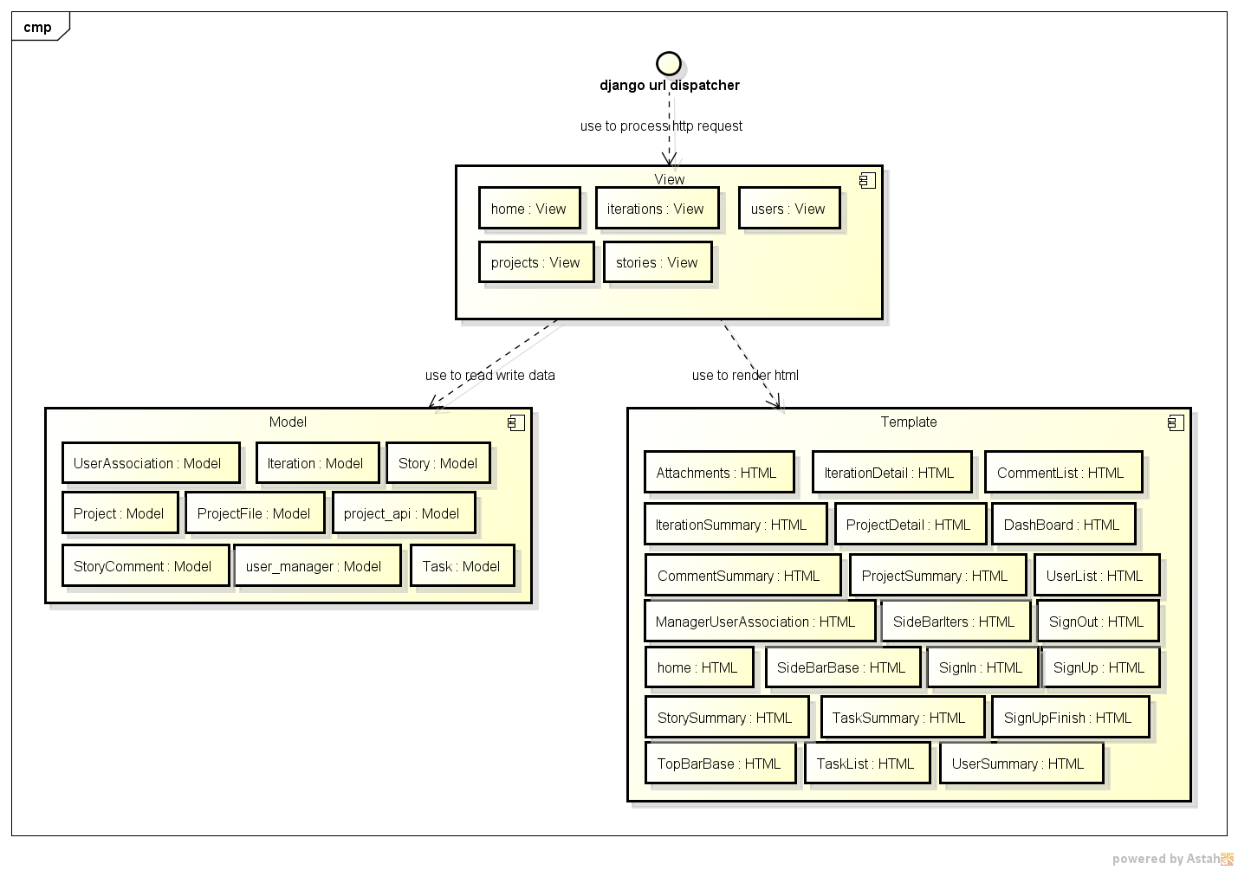
Server Architecture Diagram

Slide 19
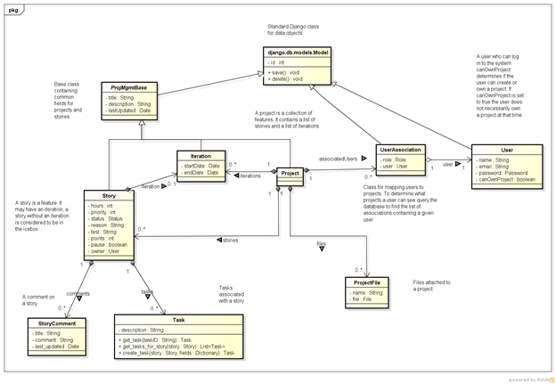
Server Architecture Diagram

Slide 20
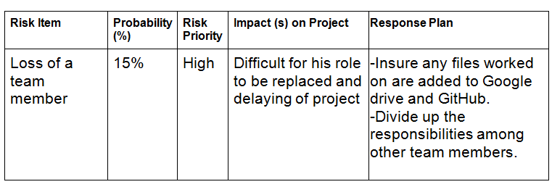
Risk Management
Identified the top 12 risks associated with our project by listing impacts and response plan.
Example:

Slide 21
Quality Management
Focus is on the number of tasks the application completes correctly.
Defect management
issues identified
issue resolved/managed
Application can be run on Android phone.

Slide 22
Testing
Unit testing
test users
System testing
register test cases
login test cases
server test cases
White box testing

Slide 23
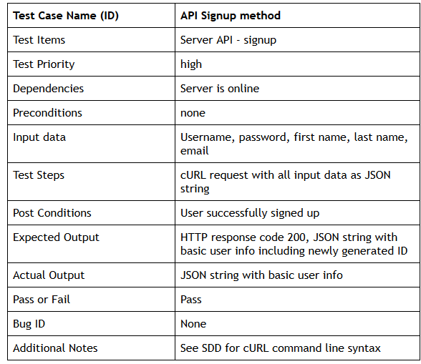
Testing Example

Slide 24
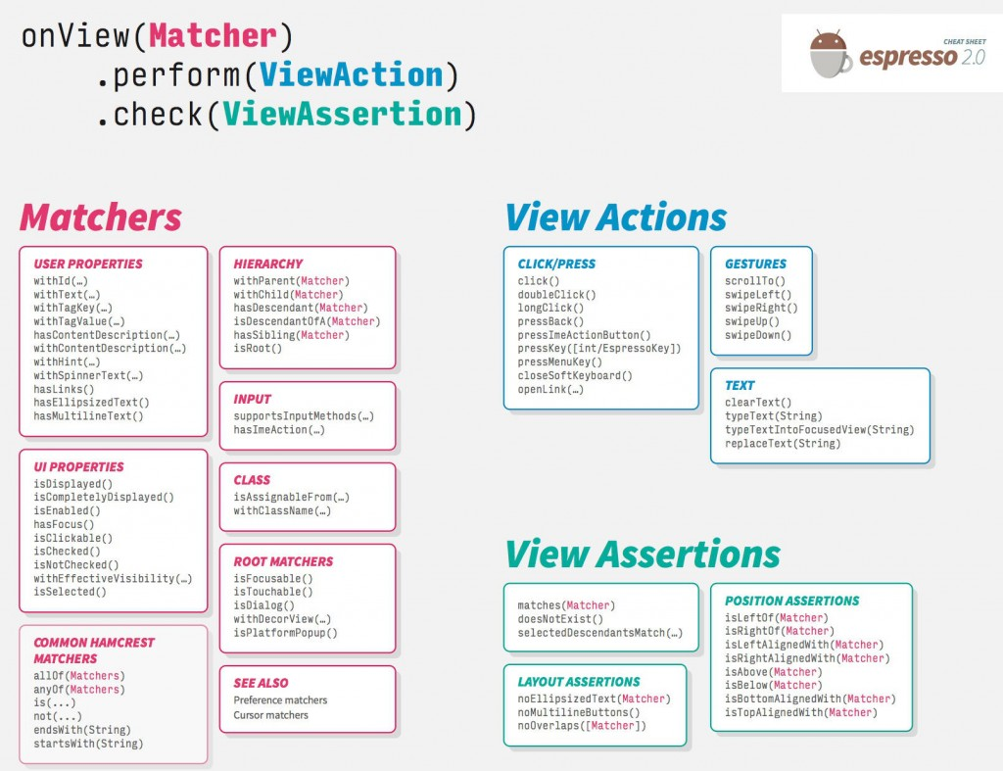
Espresso (Automation Testing)

Slide 25
Security
Added SSL layer to existing Django server
Standard validation for sign-up
minimum character length for password

Slide 26
OWASP Top 10 risks for mobile application (2014)
M1: Weak Server Side Controls
M2: Insecure Data Storage
M3: Insufficient Transport Layer Protection
M4: Unintended Data Leakage
M5: Poor Authorization and Authentication
M6: Broken Cryptography
M7: Client Side Injection
M8: Security Decisions Via Untrusted Inputs
M9: Improper Session Handling
M10: Lack of Binary Protections

Slide 27
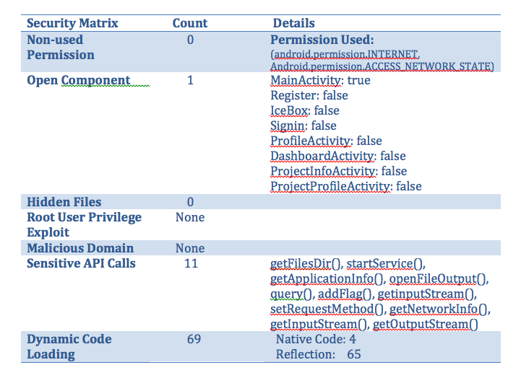
Android Security Practice
Source: androwarn(https://github.com/maaaaz/androwarn), Mobile Security Lab Boston University(http://met-mobile.bu.edu/androweb)

Slide 28
Process Improvement
Defined our tasks more clearly and made sure they were well-defined.
Every member checked-in for weekly progress updates.
Started to meet in person on the weekend to work on project.

Slide 29
Achievement
We created a basic requirement tracking tool mobile application.
It allows a user to log-in and view only projects the user is associated with.
Each project lists the different user stories that are on the iteration list and icebox list.

Slide 30
Challenges
Communication - Difficult to ensure that everyone is on the same page.
Underestimating the time it took to finish each task.
Steep learning curve for Django and Android development
Lots of documentation reading.
Running application on phone instead of on the emulator.

Slide 31
Lessons Learned
Status updates from team members to make it easier to track progress and identify where more resources is needed.
Acquired more knowledge about how web applications communicate via their APIs.
Allow more time to read documentations and tutorials.

Slide 32
DEMO

Slide 33
Questions?
Thank you.

